Slide 1

Maryam Munir | 180978
Qurat ul Ain | 181030
FYP Semester: | III
FYP-ID: | CS-SP-21-25
Date: | 16-05-2022
Fake news Detection on social media platform
Supervisor: | Sir Shoaib Malik
Evaluator 1: | Mr. Saud
Evaluator 2: | Mr. Atif Shah

Slide 2
Table of Contents
Fake News Detection on Social Media Platform
Introduction
Problem Statement
Literature Review
Software Requirements
Use-Case Diagram
Dataset Exploration
Proposed Methodology (Flow Chart)
Results
Comparison and Conclusion
References

Slide 3

Introduction
Fake News Detection on Social Media Platform
Fake news detection system not only plays significance role in general social media news but also in academic social media content. Fake news stories are designed to attract readers to spread faster due to which students have to face a lot of difficulties while finding the authentic data related to their work.

Slide 4
Problem Statement
Fake News Detection on Social Media Platform
The increasingly rapid pace of spreading fake news is considered a problem in conjunction with the increasing number of people who are relying upon social media to get news.
That earns widespread attention from research communities due to the negative impact and influence of fake news on public decisions.
The project aims to illuminate the current research on fake news problem and the process of detecting the fake news specially in academic social networks.

Slide 5
Literature Review
Fake News Detection on Social Media Platform
3 Han Deep Neural Network:
Word Count based models
Bow, tf-idf, bag of ngrams , bigram.
SVM Machine Learning Algorithm for text classification.
Neural Networks
Han avg, han max
Glove avg, glove max
Misinformation Detection on YouTube Using Video Captions:
Word Count based models
Bow, tf-idf, bag of ngrams , bigram.
Naïve Bayes Algorithm for classification

Slide 6
Software Requirements
Fake News Detection on Social Media Platform
Functional Requirements
Data Collection
Data Pre-Processing
Dataset Splitting
Model Training
Model Evaluation and Testing
Nonfunctional Requirements
Usability Requirements
Maintainability/Supportability Requirements
Performance Requirements

Slide 7
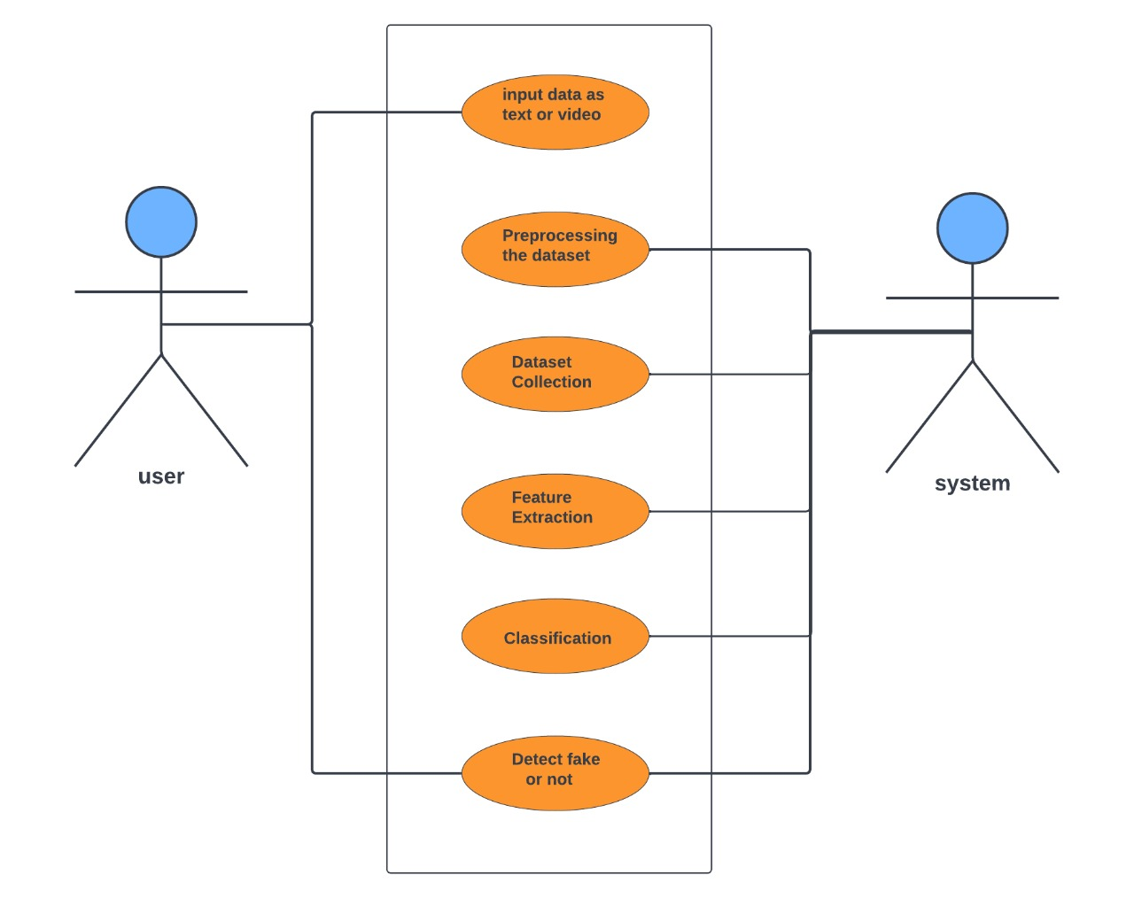
Use Case Diagram
Fake News Detection on Social Media Platform
Fig 1: Usecase diagram of the project

Slide 8
Dataset Exploration
Fake News Detection on Social Media Platform
There are a lot of datasets available online for the fake news detection on text and also on videos for example:
Misinformation of YouTube videos Dataset
ClickBait Thumbnail Dataset
Fake News Detection Dataset available on Kaggle
Liar Dataset
Politifact Datasetetc.

Slide 9
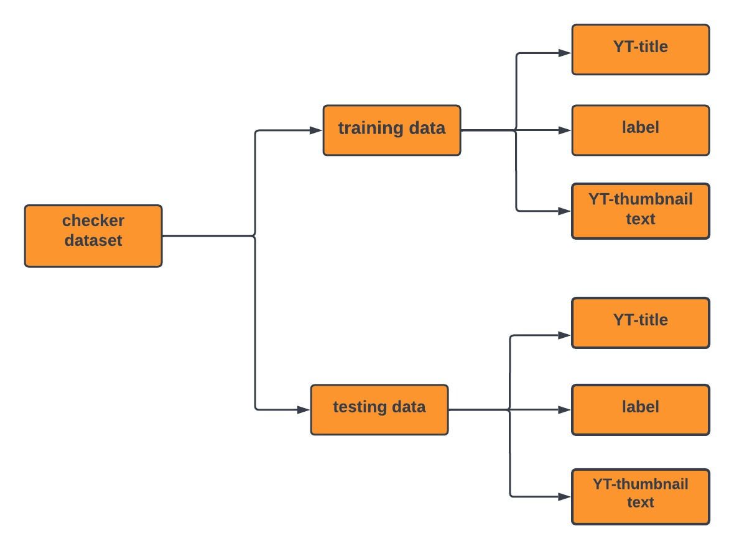
Fake News Detection on Social Media Platform
The dataset which we have used for our project is ClickBait Thumbnail Dataset whose attributes are as follows:

Slide 10
Proposed Methodology
Fake News Detection on Social Media Platform
We have used 3 different datasets in our project for getting better results that are:
Misinformation of YouTube videos Dataset
ClickBait Thumbnail Dataset
Fake News Detection Dataset available on Kaggle
Then we preprocessed our data to get ready for the training of model.
For that purpose, we cleaned our datasets by removing the stop words and the unnecessary columns.

Slide 11
Fake News Detection on Social Media Platform
After cleaning the datasets and getting the required columns in each dataset we used word count based models (e.g. bag of words (BOW) and bag of n-grams) for to extract the features from each column of the datasets.
Extracted features were then used by the machine learning models to train the model.
After training our models, we have saved our models for the testing phase.
In testing phase, we load the trained model to predict the accuracy of our dataset.

Slide 12
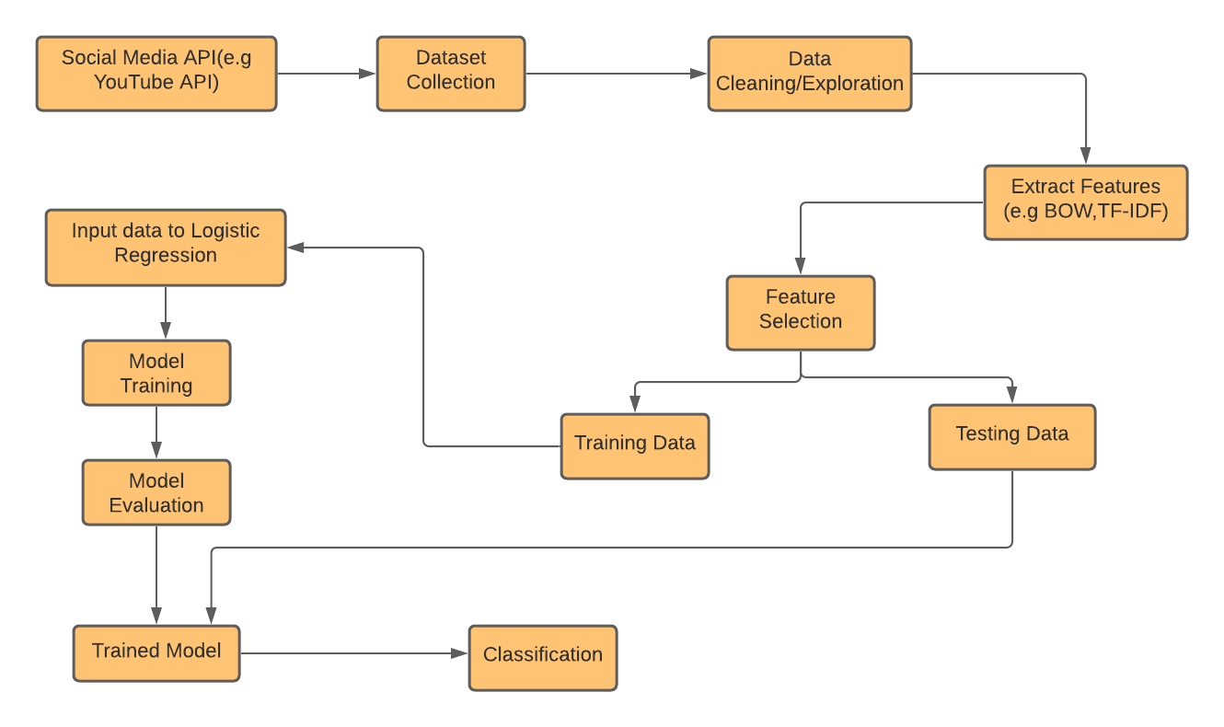
Flow Diagram
Fake News Detection on Social Media Platform
Fig 1: Flow diagram of the project

Slide 13
Tools and Technologies
Fake News Detection on Social Media Platform
We have used PYCharm compiler for running python code on it.
We have used following libraries:
Numpy
Sklearn.feature_extraction.text
Sklearn.linear_model
Nltk.corpus

Slide 14
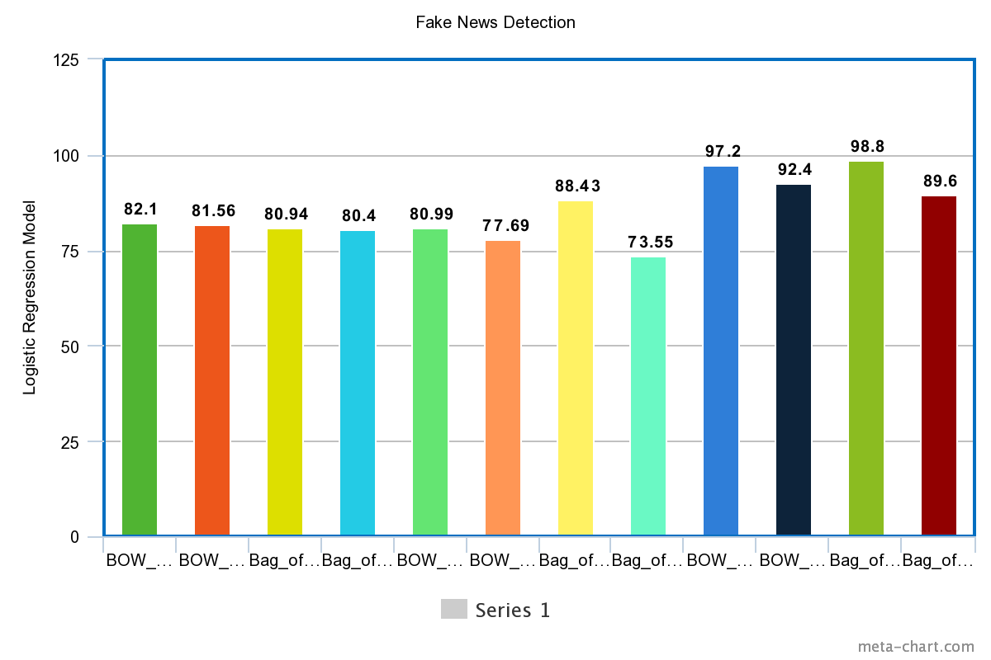
Results
Fake News Detection on Social Media Platform

Slide 15
Comparison
Fake News Detection on Social Media Platform
The previous datasets i.e Checker Dataset for ClickBait Thumbnail Detection got 79.8% accuracy and Misinformation on YouTube Videos for video detection got 83.4% accuracy and Fake News Dataset for text classification and got 95.8% accuracy in text classification, but our system got 97.04% accuracy and other 2 video datasets gives 82.25% for Checker Dataset and 85.7% for Misinformation Dataset. We have enhanced 2% accuracy on both of the text and video datasets and got these results.

Slide 16
Conclusion
Fake News Detection on Social Media Platform
With the help of Machine Learning, we are done with the single module of this system by using word count based models(e.g. bag of words(BOW), bag of ngram) .This project can be further enhanced to provide greater flexibility and performance with certain modification whenever necessary such as deep fake learning.

Slide 17
References
Fake News Detection on Social Media Platform
Xie, T., Le, T., Lee, D. (2021). CHECKER: Detecting Clickbait Thumbnails with Weak Supervision and Co-teaching. In: Dong, Y., Kourtellis, N., Hammer, B., Lozano, J.A. (eds) Machine Learning and Knowledge Discovery in Databases. Applied Data Science Track. ECML PKDD 2021. Lecture Notes in Computer Science(), vol 12979. Springer, Cham. https://doi.org/10.1007/978-3-030-86517-7_26
Singhania S., Fernandez N., Rao S. (2017) 3HAN: A Deep Neural Network for Fake News Detection. In: Liu D., Xie S., Li Y., Zhao D., El-Alfy ES. (eds) Neural Information Processing. ICONIP 2017. Lecture Notes in Computer Science, vol 10635. Springer, Cham. https://doi.org/10.1007/978-3-319-70096-0_59
Saikh T., Anand A., Ekbal A., Bhattacharyya P. (2019) A Novel Approach Towards Fake News Detection: Deep Learning Augmented with Textual Entailment Features. In: Métais E., Meziane F., Vadera S., Sugumaran V., Saraee M. (eds) Natural Language Processing and Information Systems. NLDB 2019. Lecture Notes in Computer Science, vol 11608. Springer, Cham. https://doi.org/10.1007/978-3-030-23281-8_30
Jwa, H., Oh, D., Park, K., Kang, J. M., & Lim, H. (2019). exBAKE: Automatic fake news detection model based on Bidirectional Encoder Representations from Transformers (BERT). Applied Sciences (Switzerland), 9(19), [4062]. https://doi.org/10.3390/app9194062
Thota, Aswini; Tilak, Priyanka; Ahluwalia, Simrat; and Lohia, Nibrat (2018) "Fake News Detection: A Deep Learning Approach," SMU Data Science Review: Vol. 1 : No. 3 , Article. Available at: https://scholar.smu.edu/datasciencereview/vol1/iss3/10

